Slide 1
T3 Cancer of the Stomach

Slide 2

Anatomy
Food moves from the throat
$→$ esophagus
$→$ stomach
$→$ small bowel (jejunum)

Slide 3
Cancer Staging
Staging refers to the tests to determine
How large is the tumor?
Has there been spread to lymph nodes?
Has it spread to other parts of the body?
Treatment options depend upon the cancer stage

Slide 4
Cancer Staging
T = Tumor - Depth of growth into the wall
N = Nodes - Spread to the lymph nodes
M = Metastasis - Spread to liver, lungs, or bone

Slide 5
Early Stage Cancers
Cancers start on the very inside layer called the mucosa

Slide 6
Locally-advanced Cancers
Over time, cancers can grow into the muscular wall

Slide 7
Lymph Nodes
In some cases, cancer cells can break off from the main tumor and spread to lymph nodes

Slide 8

T Stage
Cancers are categorized based upon the thickness of the tumor, known as the T stage

Slide 9

N Stage
Cancers are categorized by whether there is spread to the nodes.
N0 cancers have not spread to the nodes
N1 cancers have spread to the nodes.

Slide 10

M Stage
Some cancers spread to other parts of the body
M0 cancers have not spread to other parts of the body
M1 cancers have spread lungs, liver, or bone

Slide 11

PET scan
PET scan is similar to CT scan
Tracer shows ‘hot spots’
Cancer
Inflammation or infection
Normal organs (heart)

Slide 12

Endoscopic Ultrasound
Similar to upper endoscopy (EGD)
Ultrasound in scope
Evaluates T stage

Slide 13

Laparoscopy
Some stomach cancers can spread inside the abdomen
Areas of spread can be very small (grain of rice)
Laparoscopy can detect spread inside the abdomen

Slide 14
Laparoscopy
General anesthetic
Several 1/4” incisions 1/4”
Telescope examines the abdomen
Biopsies can be performed.

Slide 15
Treatment Plan
Superficial (T1) $⇒$ Endoscopic Therapy Localized (T1b/T2) $⇒$ Surgery Locally-advanced (T3/N1) $⇒$ Chemo $→$ Surgery$→$Chemo Metastatic (M1) $⇒$ Chemotherapy

Slide 16
Locally-advanced Adenocarcinoma
“Sandwich” chemotherapy before + after surgery:
Chemo (8 wks) $→$ Surgery $→$ Chemo (8 wks)
Two different drug combinations:
FLOT (more effective)
FOLFOX (better tolerated)

Slide 17
“Sandwich” Chemotherapy Drugs
FLOT
5-FU
Leucovorion
Oxaliplatin
Taxotere
FOLFOX
5-FU
Leucovorin
Oxaliplatin

Slide 18
Tumor Biomarkers
Pathology tests show whether other drugs may be helpful:
HER-2 $→$ Herceptin can be helpful
PD-L1 $→$ Immunotherapy can be helpful
MMR $→$ Immunotherapy can be helpful
Biomarkers reported in a separate pathology report
Your medical oncologist will review these with you

Slide 19
Chemotherapy Administration
Most chemotherapy is administered by vein.
Several options exist to administer chemotherapy:
Intravenous catheter in peripheral veins
Peripheral Intravenous Central Catheter (PICC)
Central Venous port

Slide 20
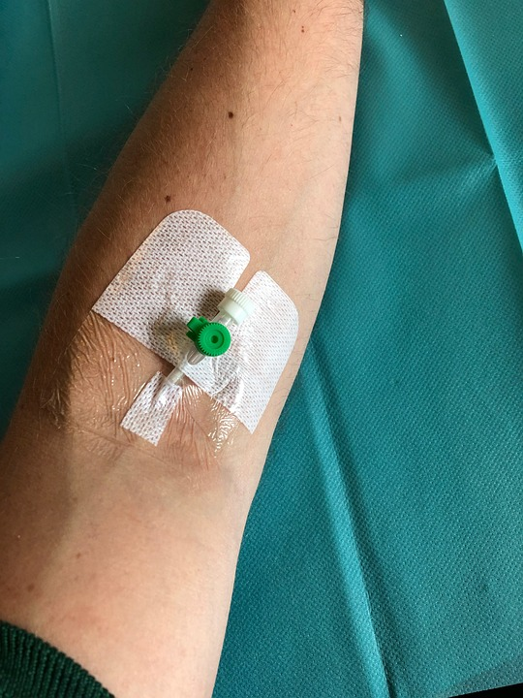
Intravenous Catheter in Peripheral Vein (“IV”)
IV catheter placed in vein of hand or arm
Allows administration of chemo and fluids
Placed for each dose
Removed that day
Not suitable for FLOT chemo

Slide 21
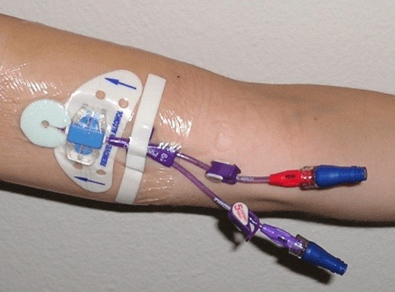
PICC Lines
Placed in Radiology
Stay in place during all of treatment
Needs to be kept clean and dry
Suitable for FLOT chemotherapy

Slide 22
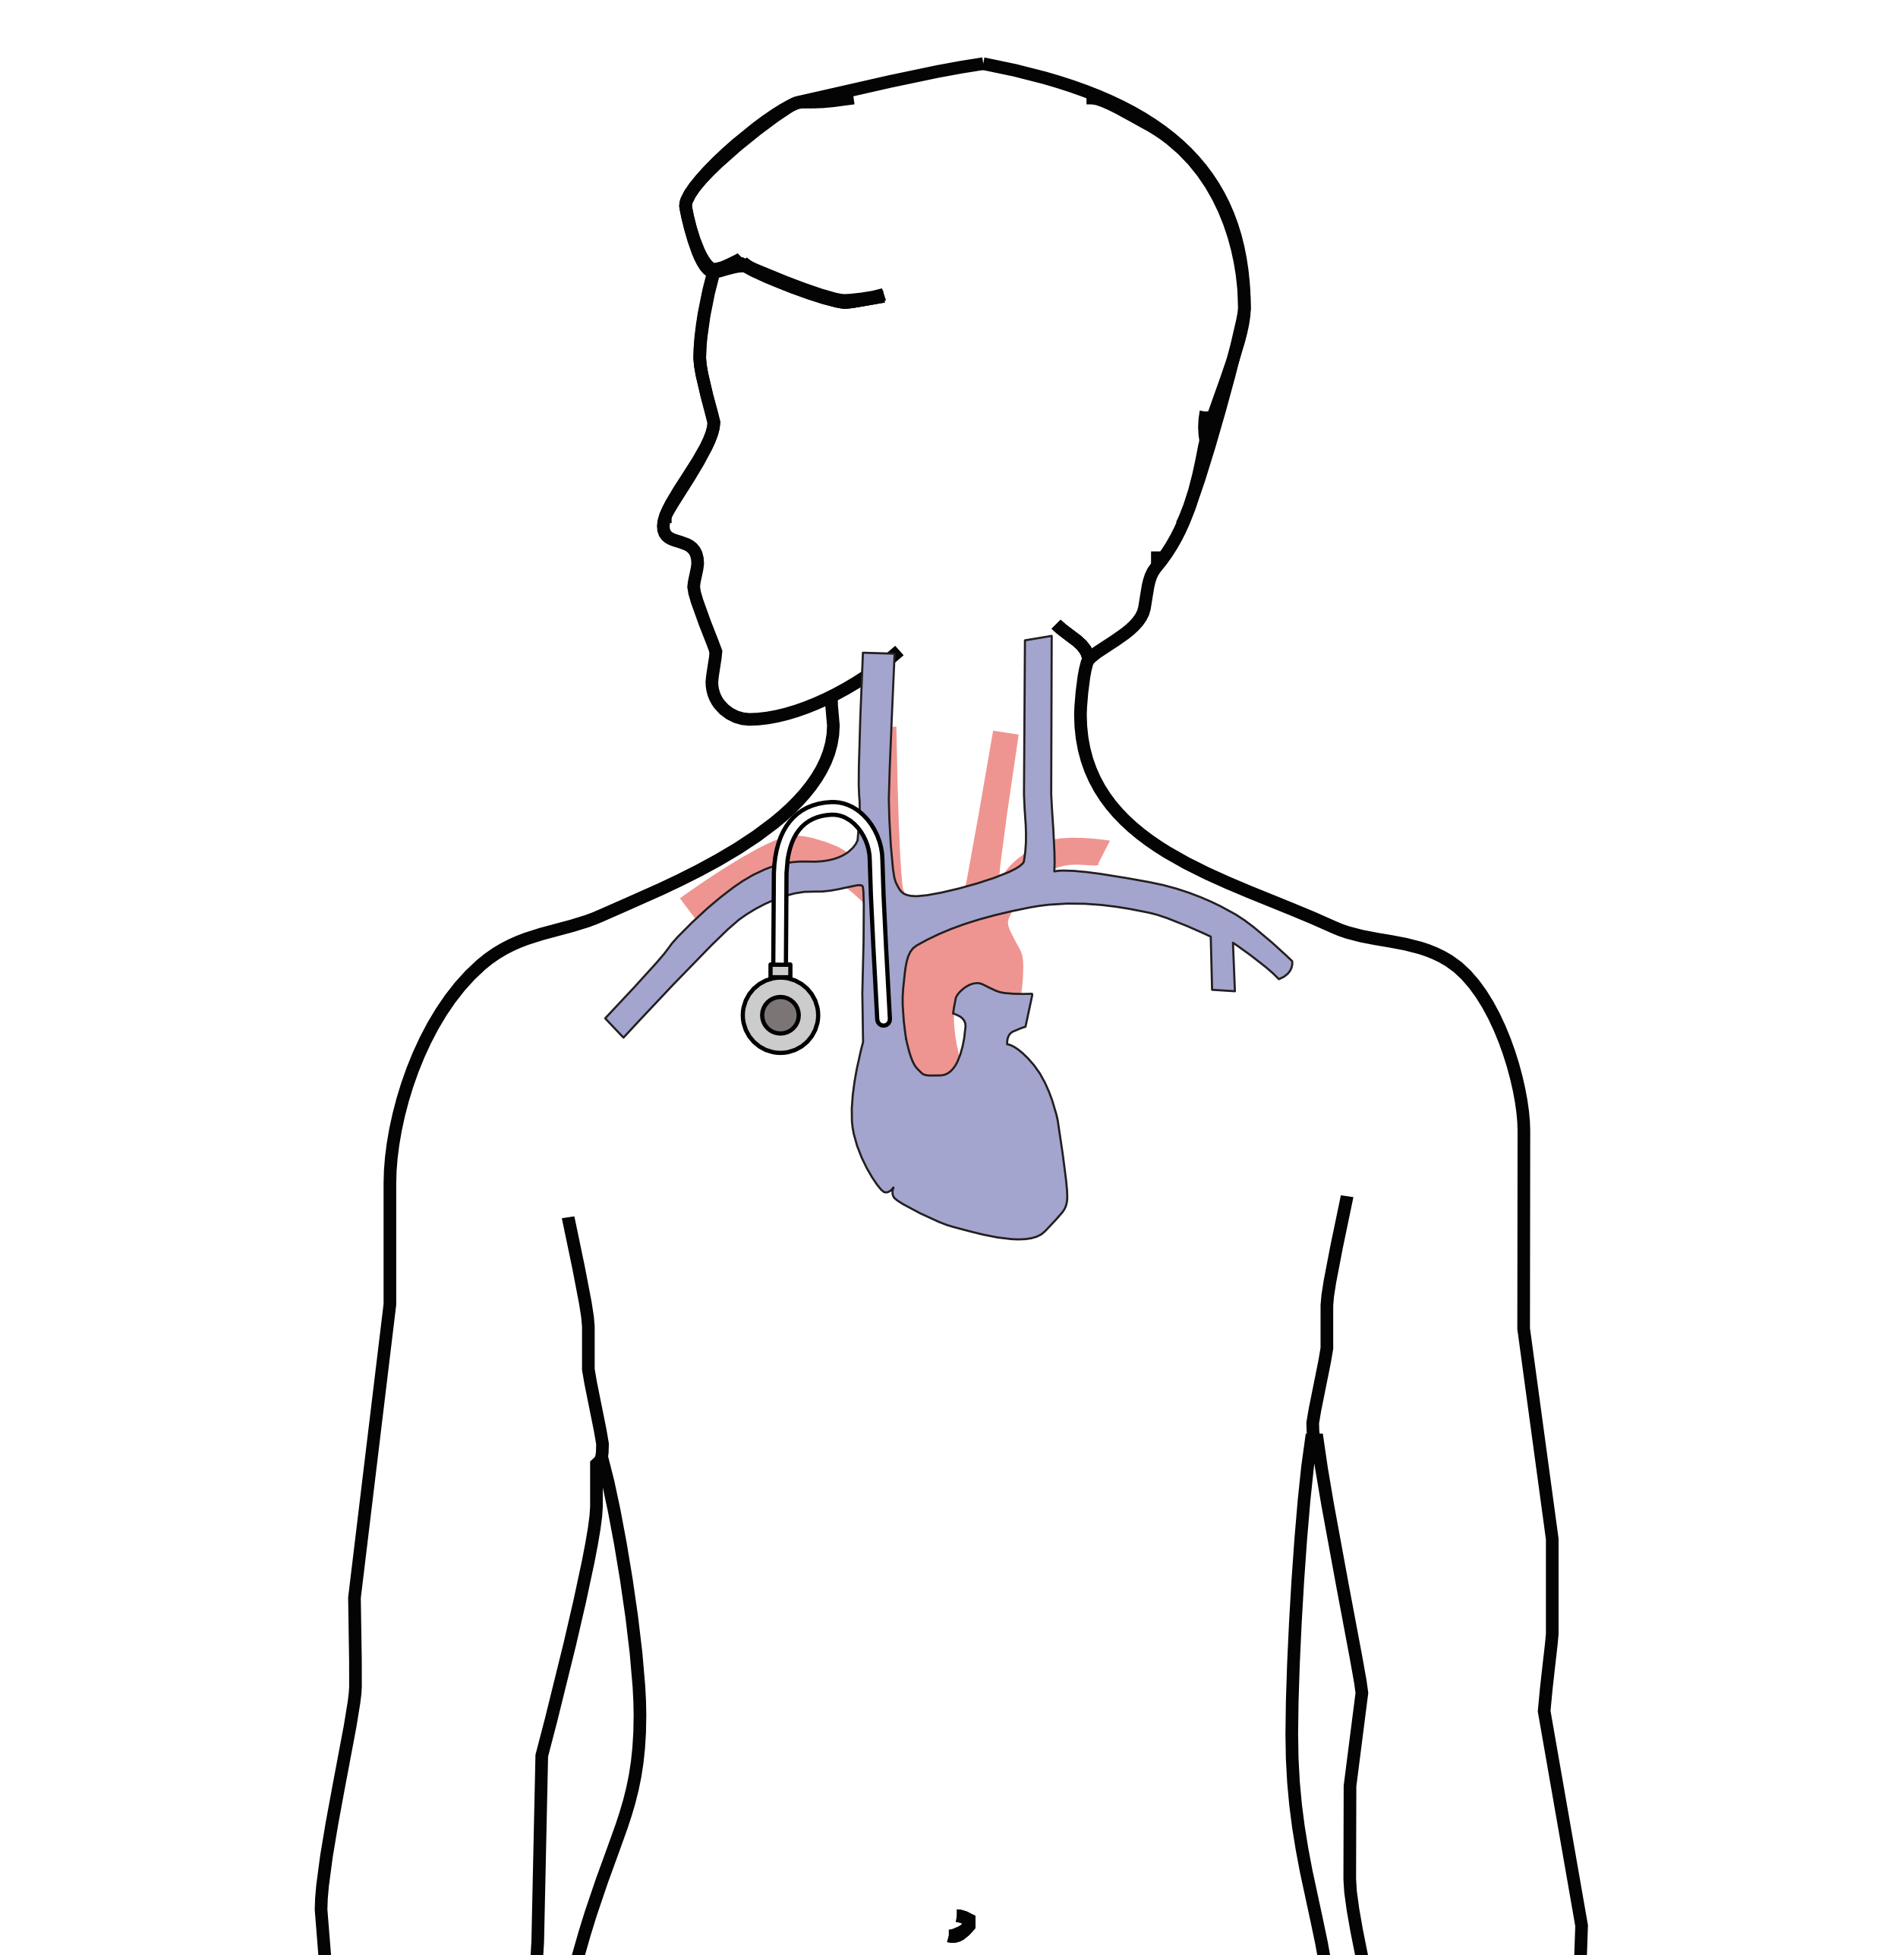
Central Venous Port
Implantable device makes chemo easier
May shower in 24 hrs
No special care at home
OK for FLOT chemo
Allows for blood draws

Slide 23
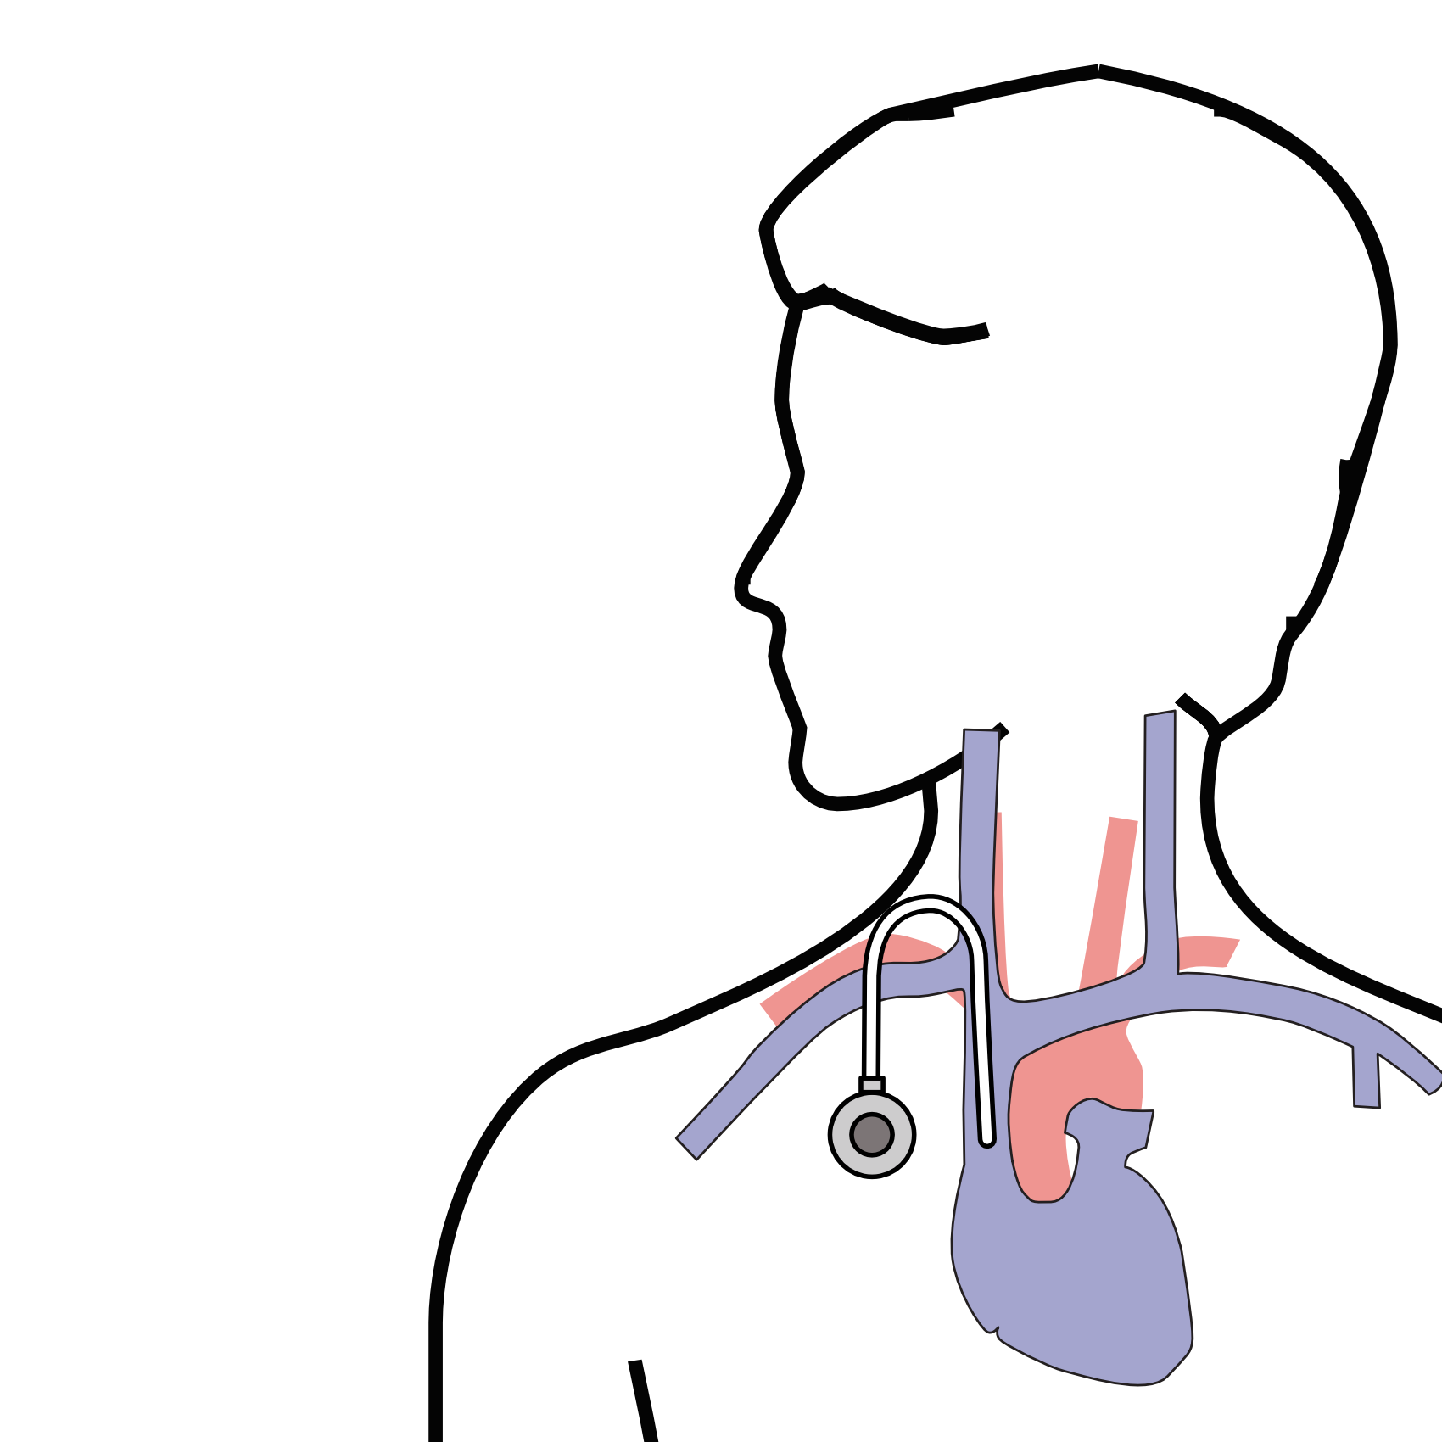
Central Venous Port
Implanted under the skin
Neck incision (1/4”)
Incision below the collarbone
Sutures dissolve
“Superglue” on incisions

Slide 24
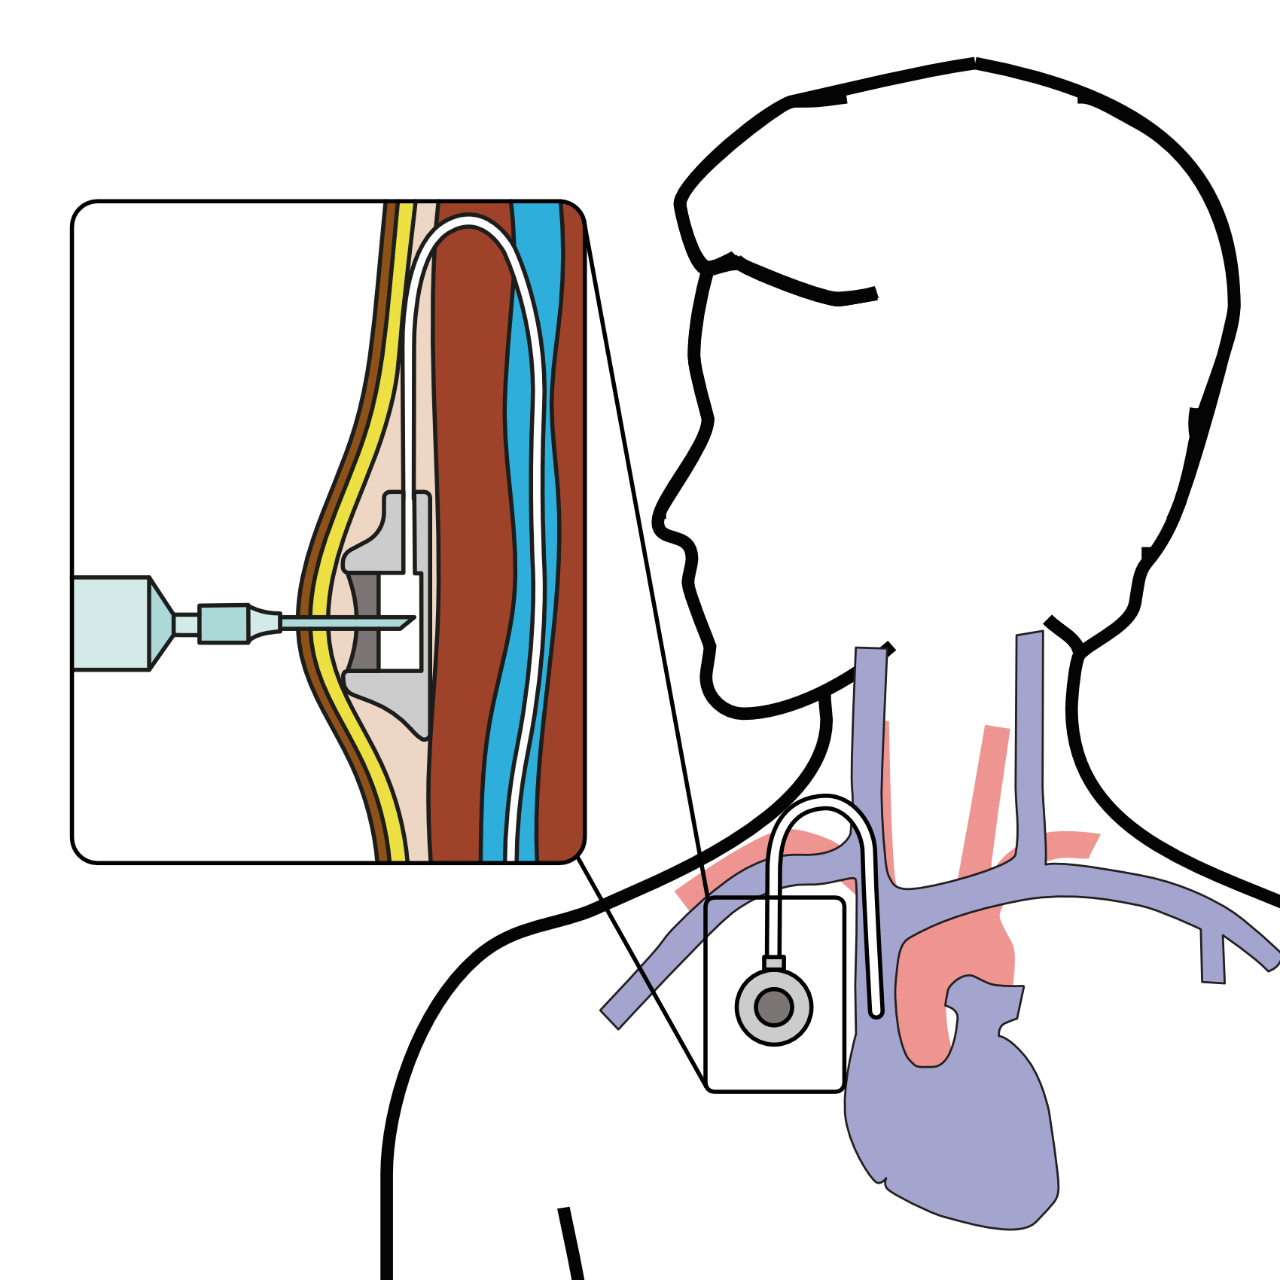
Central Venous Port
When it is time for chemotherapy, a needle is inserted through the skin into the port

Slide 25
Restaging
CT or PET scan performed after preoperative therapy
Surgery performed after restaging
Timing depends upon recovery from therapy

Slide 26
Primary Care Practitioner (PCP)
Critical to coordinate care between specialists.
We will update your PCP after each visit
PCP Referral Line (844) 235-6998

Slide 27
My Atrium Patient Portal
Critical to good communication with your care team
Available for desktop or laptop or phone
Sign up at my.atriumhealth.org

Slide 28
Exercise
Reduces risk of complications from treatment
Goal is 30min/day of vigorous exercise 6 days/week
Working hard enough that you can’t converse
Start slowly and build up
Every day counts! (Aim for daily activity)

Slide 29
Smoking Cessation
Smoking makes cancer treatment more difficult
Increases risk of complications after surgery
Options for help with smoking cessation:
NC Quit Line 1-800-QUIT-NOW (1-800-784-8669)
American Lung Assn www.freddomfromsmoking.org
Smoking Cessation Counseling (Metro Charlotte)

Slide 30
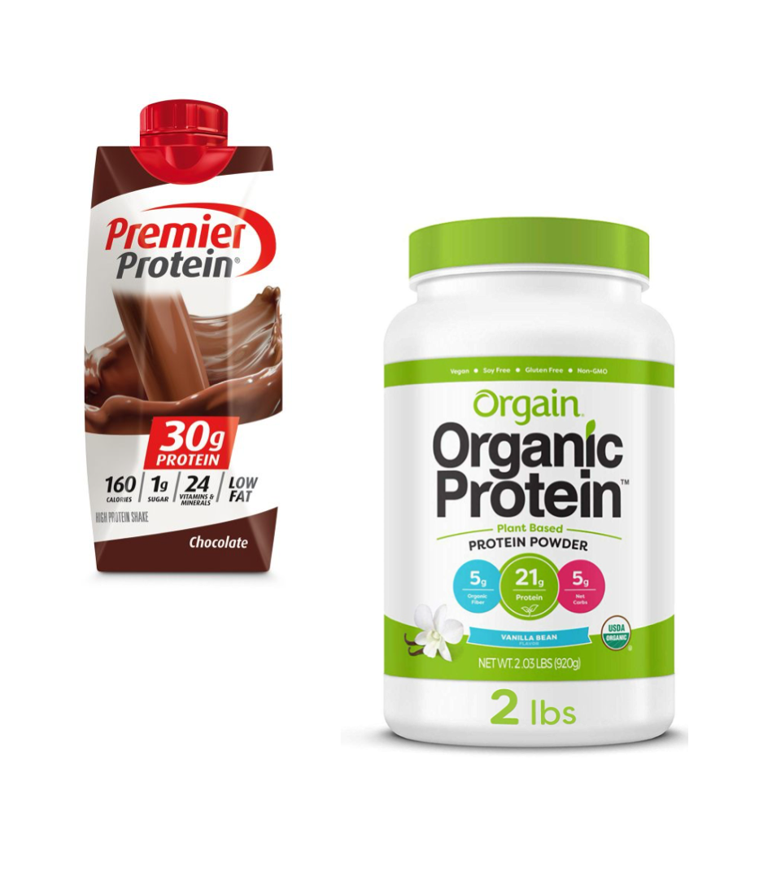
Protein Needs
Men: Average 75 grams/day
Women: Average 60 grams/day
Protein Shakes provide protein with minimal sugar

Slide 31
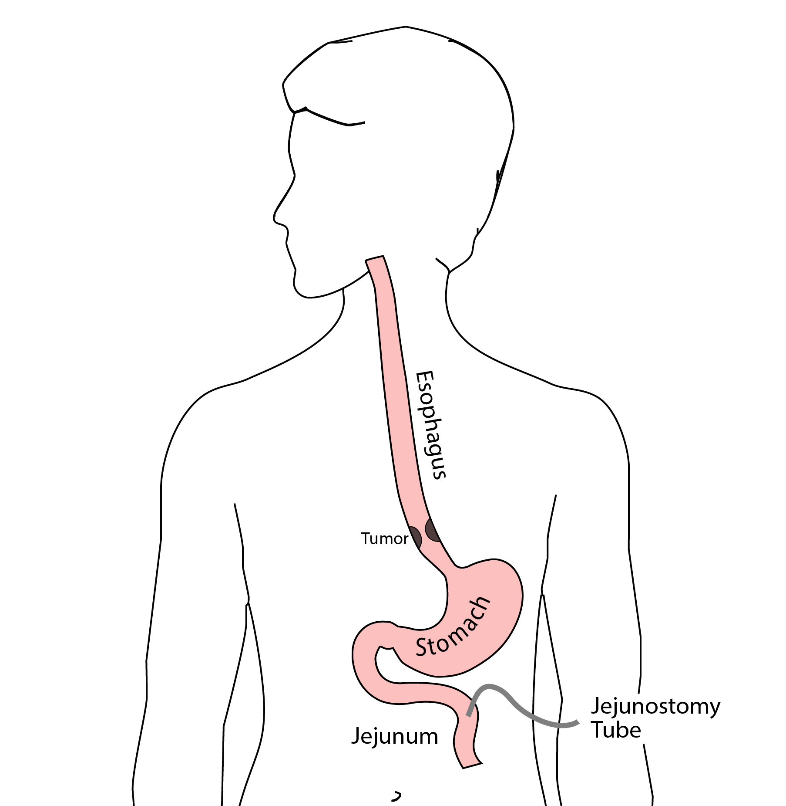
Jejunostomy Tube
Nutrition to bypasses the esophagus and stomach
Placed in small intestine
Pump administers feedings slowly
Feeding usually done at night

Slide 32
Jejunostomy Typical Regimen
Jejunostomy tube feeds for 16 hours (6pm-10am)
Men: 75mL/hour x 16 hours = 5 cartons
Women: 60mL/hour x 16 hours = 4 cartons
Water 240ml (8oz) via syringe 4x/day
Hospital nurses will teach use of the feeding tube

Slide 33
Jejunostomy Feeds with Diabetes
Jejunostomy feedings elevate blood sugars
Insulin may be required along with feeds
Typical Pattern for tube feeds
Feeds run via pump from 6pm to 10am
Insulin at 6pm (70/30 insulin)
Insulin at Midnight (70/30 insulin)
No insulin if tube feedings are not run

Slide 34
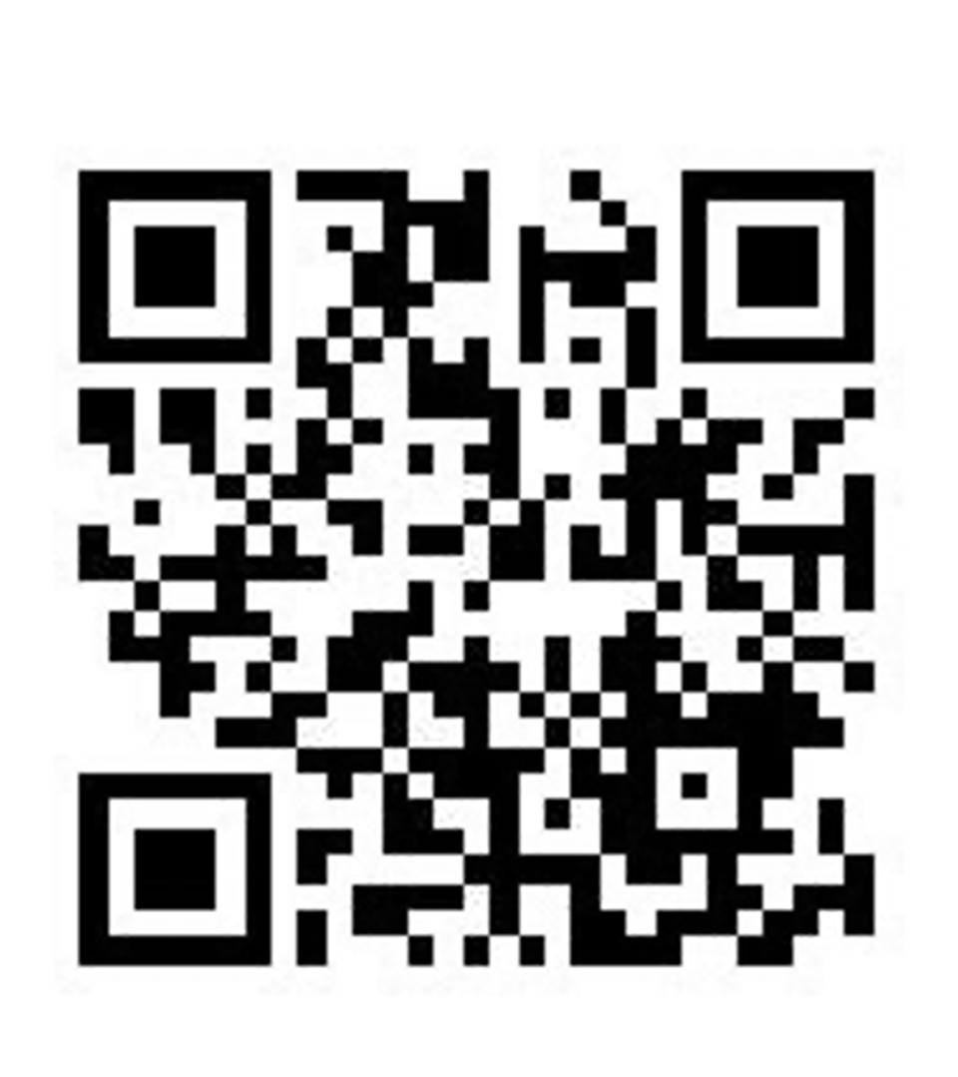
Jejunostomy Video
A video is available to help become familiar with the feeding jejunostomy

Slide 35
Stomach Cancer Surgery Goals
Staging refers to the tests to determine
Remove the tumor
Remove lymph nodes (depends upon tumor type)
Preserve stomach function
Reconstruct GI tract
Treatment options depend upon the cancer stage

Slide 36
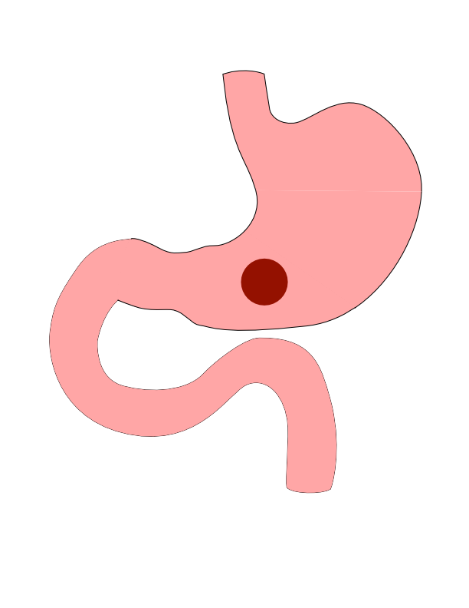
Distal Cancers
Distal cancers are those in the lower part of the stomach

Slide 37
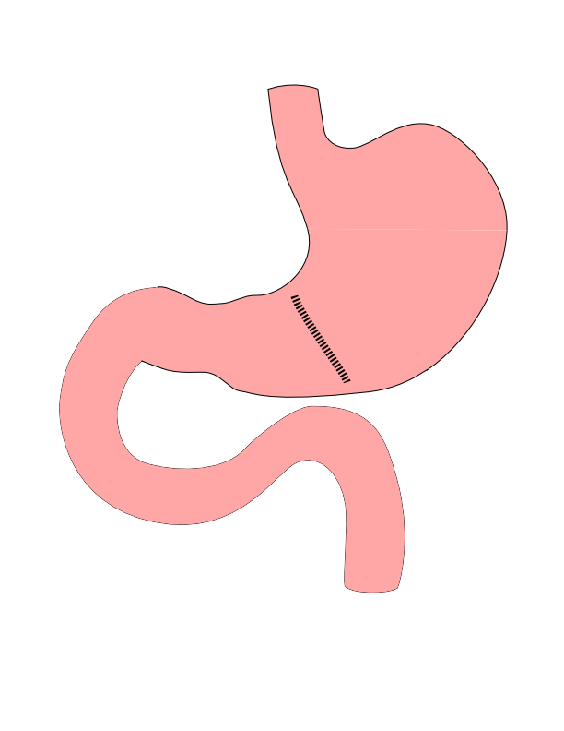
Partial Gastrectomy
Removes the tumor
Does not remove lymph nodes
Best suited for:
Small adenocarcinoma
GI Stromal Tumors

Slide 38
Partial Gastrectomy

Slide 39
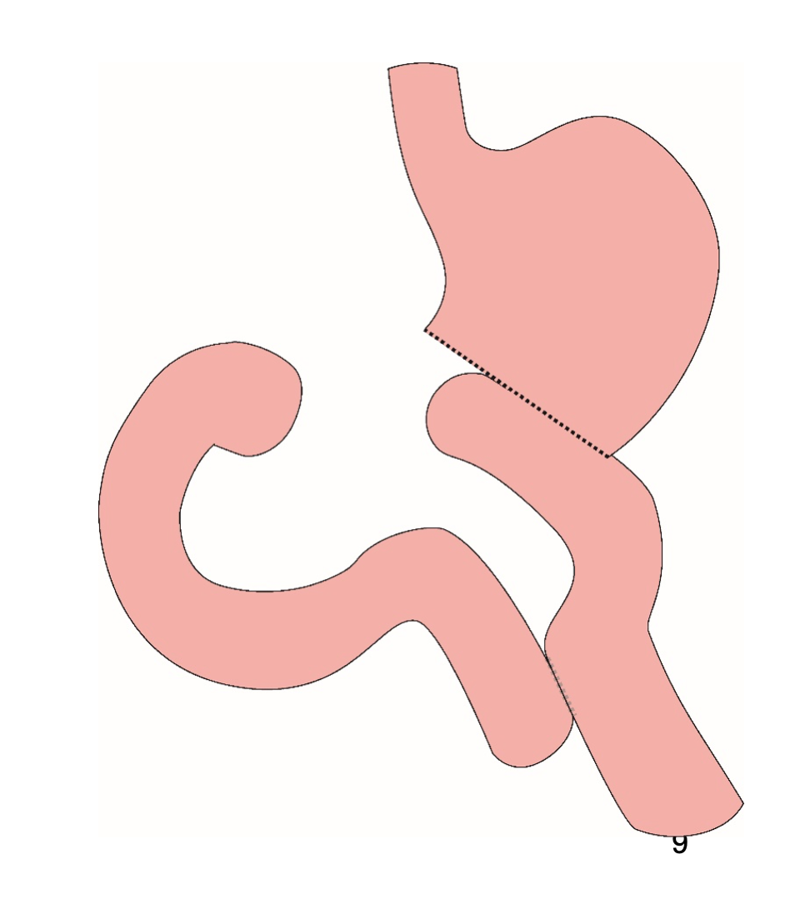
Distal Gastrectomy
Removes bottom half of the stomach
Does not remove all lymph nodes

Slide 40
Distal Gastrectomy

Slide 41
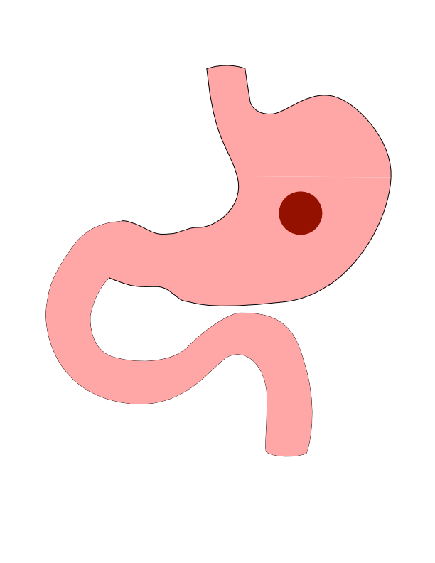
Body Cancers
Body is the mid-portion of the stomach

Slide 42
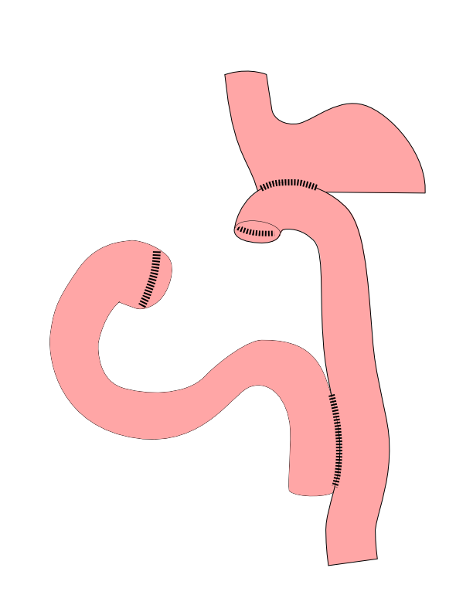
Subtotal Gastrectomy
Removes bottom 2/3 of stomach
Removes nearby lymph nodes
Reconstruction with small intestine

Slide 43
Subtotal Gastrectomy

Slide 44
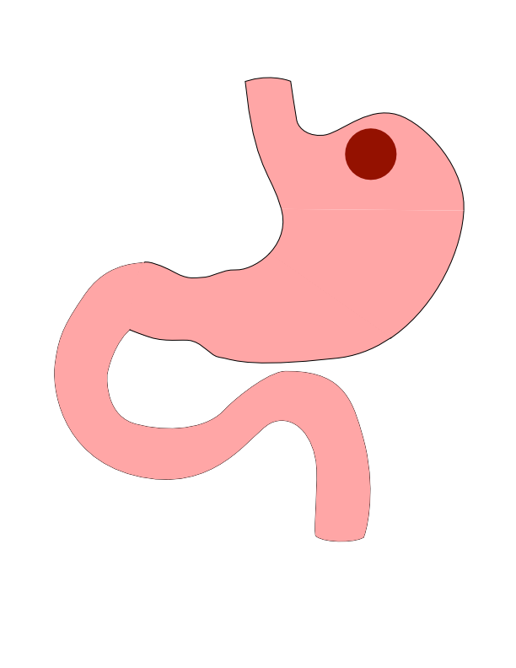
Proximal Tumors
Located near the top of the stomach
Challenging area for surgery

Slide 45
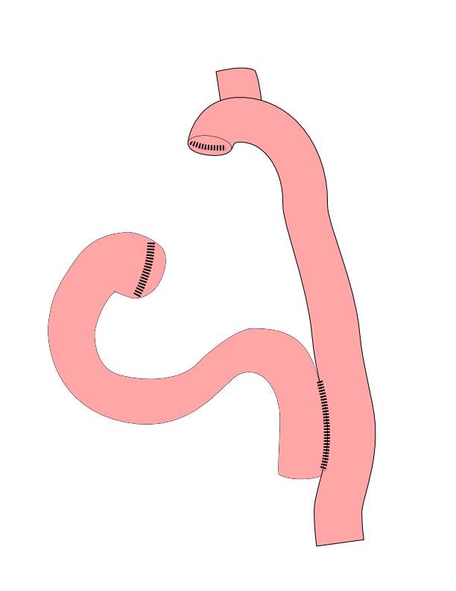
Total Gastrectomy
Removes all of the stomach
Reconstruction with small intestine
Needed for those with CDH1 mutations

Slide 46
Total Gastrectomy

Slide 47
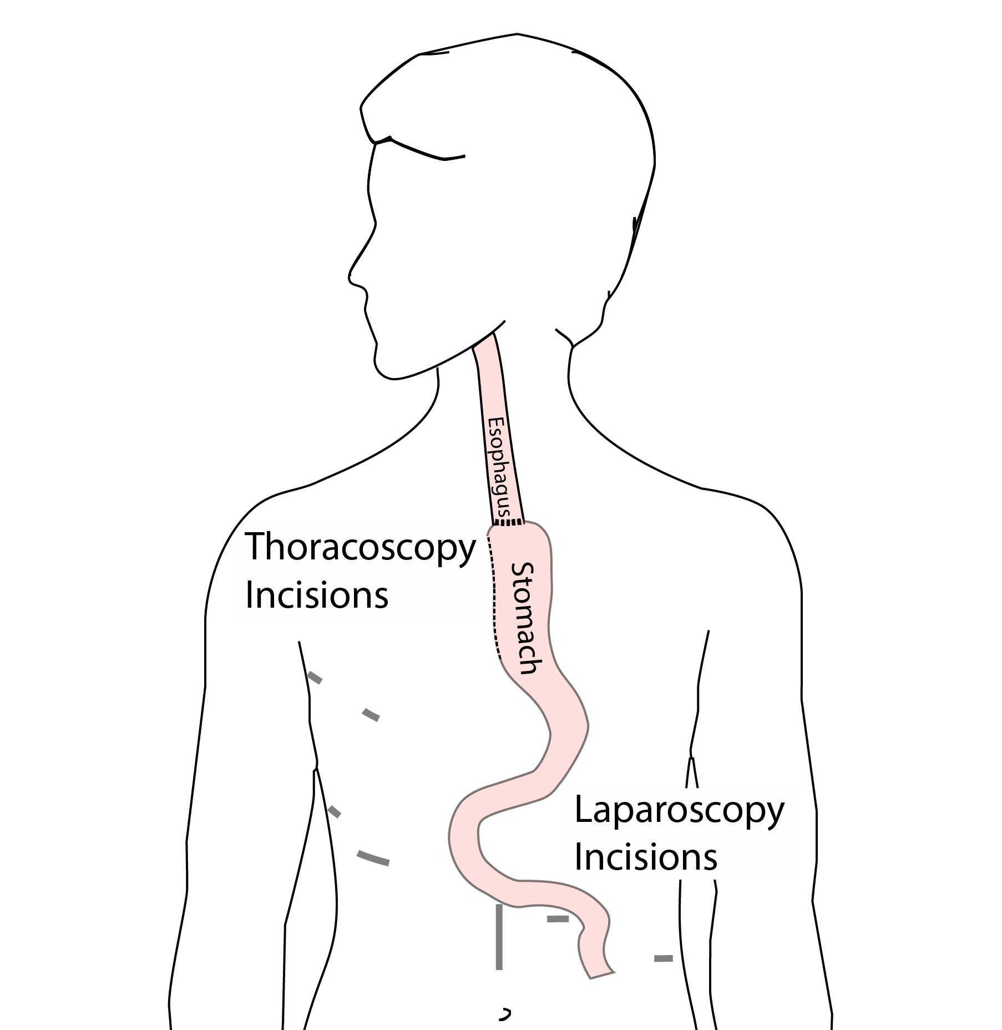
Esophagogastrectomy
Removes top part of stomach
Remove bottom half of esophagus
Surgery in both abdomen and chest

Slide 48
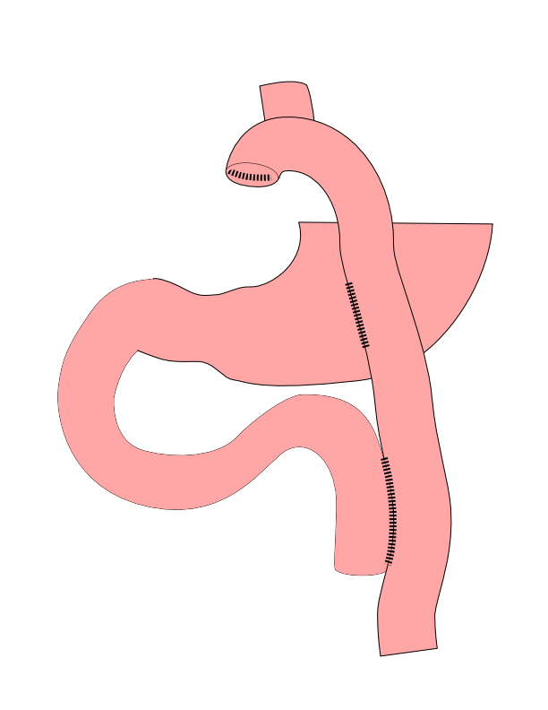
Dual Tract Gastrectomy
Alternative surgical approach for small tumors near the top of the stomach
Preserves the bottom of the stomach as a reservoir

Slide 49
Dual Tract Gastrectomy

Slide 50
Laparoscopy
Some stomach cancers can spread inside the abdomen
Areas of spread can be very small (grain of rice)
Laparoscopy can detect spread inside the abdomen

Slide 51
Laparoscopy
General anesthetic
Several 1/4” incisions 1/4”
Telescope examines the abdomen
Biopsies can be performed.

Slide 52
Risks of Surgery
Leak where bowel is joined together (anastomosis)
Bleeding requiring reoperation
Delayed stomach function
Infection in the abdomen

